Slide 1

Strategies To Reduce Caesarean Sections During Labour
Rohana Haththotuwa
Secretary General, AOFOG
Acknowledgement; Prof Sir Sabaratnam Arulkumaran

Slide 2
Disclosure of Conflict of Interest
I have no COI
with regard to our presentation.

Slide 3
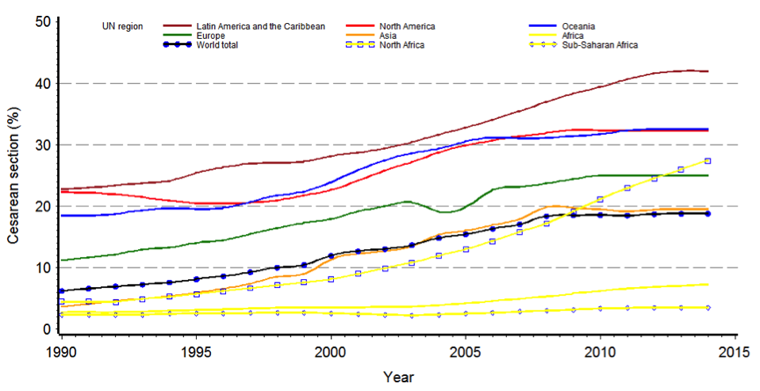
Global and regional trends in Caesarean section rates, 1990-2014

Slide 4
Highest CS rates are in the groups 1,2 & 5
Robson groups;
1. Nulliparous women with singleton cephalic pregnancy = >37 weeks in spontaneous labour
2. Nulliparous women with singleton cephalic pregnancy => 37weeks who either had labour
induced or delivered by CS before labour
5. All multiparous women, with at least one previous uterine scar and a single cephalic
delivery = > 37 weeks**
**Primary CS is the route cause for escalating CS

Slide 5
Indications for primary cesarean delivery
Data from Barber et al.
ACOG. Safe prevention of primary cesarean delivery.
Am J Obstet Gynecol 2014.

Slide 6
 | Indication | %
Prelabor | Malpresentation | 10–15*
 | Multiple gestation | 3
 | Hypertensive disorders | 3
 | Macrosomia | 3
 | Maternal request | 2–8
In labor | First-stage arrest | 15–30*
 | Second-stage arrest | 10–25
 | Failed induction | 10
 | Nonreassuring fetal heart rate | 10
Major Indications for Primary Cesarean Delivery
Data from Zhang J, Troendle J, Reddy UM, Laughon SK, Branch DW, Burkman R, Landy HJ, Hibbard JU, Haberman S, Ramirez
MM, Bailit JL; Consortium on Safe Labor. Contemporary cesarean delivery practice in the United States. Am J Obstet Gynecol 2010;203:326.e1-326.e10. Epub 2010 Aug 12
*Barber EL, Lundsberg LS, Belanger K, Pettker CM, Funai EF, Illuzzi JL.
Indications contributing to the increasing cesarean delivery rate. Obstet Gynecol 2011 Jul;118:29–38.

Slide 7
Steps towards Safe reduction of Cesarean deliveries during labour
Revisiting the definition of labour dystocia
Improved fetal heart rate interpretation & management
Labour care guide
Reconsidering induction of labour
Increasing skills of certain procedures – operative vaginal delivery
External cephalic version
Twin delivery
5. increasing access to non-medical interventions

Slide 8
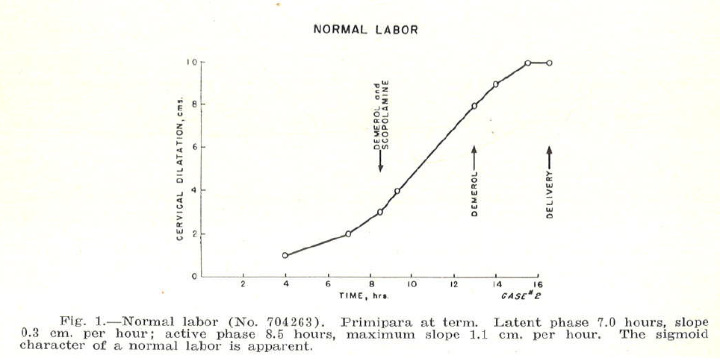
Friedman, 1954
Maximum slope
1.1 cm/ hour
Not the slowest
10’th centile
Going back to the basics

Slide 9
Contemporary Patterns of Spontaneous Labor With Normal Neonatal Outcomes Jun Zhang, PhD, MD, Helain J. Landy, MD, D. Ware Branch, MD, Ronald Burkman, MD, Shoshana Haberman, MD, PhD, Kimberly D. Gregory, Christos G. Hatjis, MD, Mildred M. Ramirez, MD, Jennifer L. Bailit, MD, MPH, Victor H. Gonzalez-Quintero Paul MPH, Judith U. Hibbard, MD, Matthew K. Hoffman, MD, MPH, Michelle Kominiarek, MD, Lee A. Learman, MD, PhDVan Veldhuisen, PhD, James Troendle, PhD, and Uma M. Reddy,
In a large, contemporary population,
the rate of cervical dilation accelerated after 6 cm, and
progress from 4 cm to 6 cm was far slower than previously described.
Allowing labor to continue for a longer period before 6 cm of cervical dilation may reduce the rate of intra-partum and subsequent repeat cesarean deliveries in the United States.
Diagnoses of active phase protraction or labour arrest should not be diagnosed <6cm dilation.
95th percentile rate of active-phase dilation was substantially slower than the standard rate derived from Friedman’s work,
varying from 0.5 -0.7 cm/h for nulliparous women and
from 0.5 -1.3 cm/h for multiparous women
(Obstet Gynecol 2010;116:1281–7) LEVEL OF EVIDENCE: III

Slide 10
Alert line 1 cm/ hour
After 5cm?
Action line 3 hours
To the right?

Slide 11
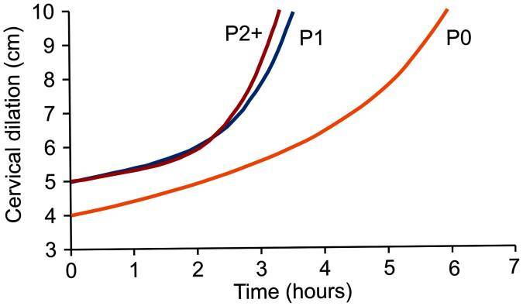
Reassessment of the labour curve in nulliparas – Zhang et al. 2010
Active phase of labor may not start until 5 cm of cervical dilation in multiparas and even later in nulliparas
A 2-hour threshold for diagnosing labor arrest may be too short before 6 cm of dilation,
Given that cervical dilation accelerates as labor advances, a graduated approach based on levels of cervical dilation to diagnose labor protraction and arrest is proposed.
26,838 women with singleton term gestation, with Vertex presentation
spontaneous onset of labour,
vaginal delivery, and a normal perinatal outcome
Zhang J, et al. Obstet Gynecol. 2010; 116:1281-7.
Going back to the basics

Slide 12

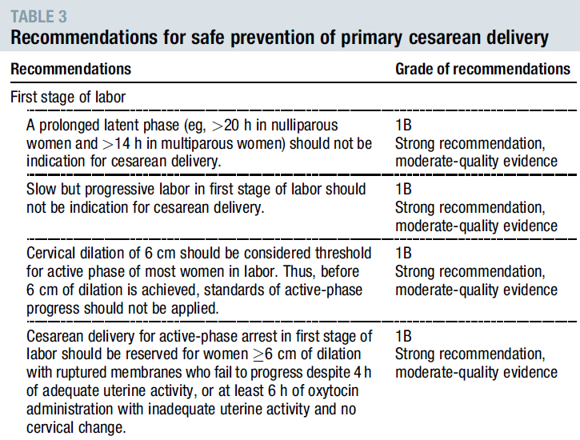
Notes:
Based on Zhang et al findings, ACOG/SMFM published the following recommendations in 2014

Slide 13
Second Stage of Labour
Factors affecting the length of second stage
Parity,
Delayed pushing,
use of epidural analgesia,
maternal body mass index,
birth weight,
occiput posterior position, and fetal station at complete dilation

Slide 14
Second Stage of Labour
Appropriate duration of the second stage is not straightforward as it involves multiple short term and long term fetal and maternal outcomes.
A longer duration of the second stage of labor is associated with adverse maternal outcomes,
higher rates of puerperal infection,
third-degree and fourth-degree perineal lacerations, and
postpartum hemorrhage.
Chances of spontaneous delivery reduces with each hour of the 2nd stage
A specific absolute maximum length of time spent in the second stage of labor beyond which all women should undergo operative delivery has not been identified
if the maternal and fetal conditions permit,
at least 2 hours of pushing in multiparous women and
at least 3 hours of pushing in nulliparous women should be allowed

Slide 15
Operative Vaginal delivery
With increasing CS rates Operative vaginal deliveries have decreased
Fewer than 3% of women in whom Operative vaginal delivery has been tried go on for CS
In one survey,
most (55%) resident physicians in training did not feel competent to perform a forceps delivery upon completion of residency
Powell J, Gilo N, Foote M, Gil K, Lavin JP.
Vacuum and forceps training in residency:experience and self-reported competency.
J Perinatol 2007;27:343-6
Attempts at OVD is acceptable in selected cases of
Midpelvic station
Occipito transverse or posterior position
These require high level of skill

Slide 16
Inexperience or inadequate skills in performing an assisted vaginal delivery
Inexperience or inadequate skills in performing an assisted vaginal delivery have been associated with a greater frequency of CS use, especially in settings where there is little training and supervision, and young physicians are afraid of showing signs of incompetency or of asking senior staff for support
In many settings, young obstetricians have become experts in CS, but are losing confidence in undertaking vaginal assisted deliveries and breech deliveries.
Litorp H, Mgaya A, Mbekenga CK, Kidanto HL, Johnsdotter S, Essen B. Fear, blame and transparency: obstetric caregivers’ rationales for high caesarean section rates in a low-resource setting. Soc Sci Med 2015; 143: 232–40.
Bailey PE. The disappearing art of instrumental delivery: time to reverse the trend. Int J Gynaecol Obstet 2005; 91: 89–9B6

Slide 17
Fetal Heart Monitoring
Considerable variation and interpretation of the fetal heart tracings.
Unnecessary CS s due to limited knowledge of FH tracing interpretation and lack of guidelines to manage
Category III
Absent FHR variability with recurrent late decelerations
Recurrent variable decelerations, or Bradycardia
Sinusoidal rhythm
Abnormal and if intra uterine resuscitatory measures does not resolve quickly needs rapid delivery
Category I
Moderate variability, presence of accelerations
Normal & does not require intervention . Ongoing monitoring

Slide 18
Fetal Heart Monitoring
Category II
Indeterminate, non-reassuaring FHR account for most CS
Require – evaluation, continued surveillance, corrective measures.
Change of position
Amnioinfusion with N. Saline
Scalp stimulation to elicit fetal heart acceleration - reassuaring
Recurrent variable decelerations, Prolonged bradycardia require delivery
No data to support delivery for decelerations with “atypical features

Slide 19
WHO RECOMMENDATION
Recent evidence highlighted
The individual variability of the progress of labours Many women do not experience a labour that conforms to the average rate on which the partograph design was based.
In 2018, the WHO initiated a process to revise the partograph Taking to account emerging evidence on normal labour progression, & Other recommendations made towards improving experience of childbirth
Designed a new labour monitoring tool called the
WHO Labour Care Guide

Slide 21
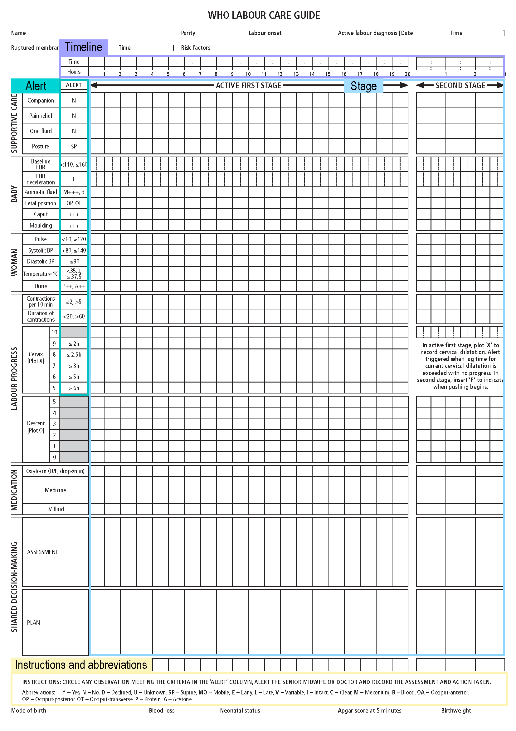
WHO LABOUR CARE GUIDE
Observe alert parameters
Under each observation.

Slide 22

Section 1: Identification and admission Section 2: Supportive care

Slide 23
international Journal of Reproduction, Contraception, Obstetrics and Gynecology Poornima H. N., Nayanashree V.*, Premalatha H. L., Nirmala Doreswamy 2023Aug;12(8):2399-2402
Background To assess whether labour monitoring using new WHO LCG will result in reducing intra partum caesarean section
Results: In the present study, the New WHO Labour Care guide was plotted for 1735pregnant women among which 1668 (96%) of the total patients had vaginal delivery, while 67 (4%) of the patients underwent Cesarean Section. Among the patients who underwent Cesarean Section it was found that1082 (94%) of the total Cesarean Sections were in latent phase of labour before plotting of the new WHO Labour care guide whereas only about 67 (6%) of Cesarean Section were conducted in active phase of labour. Among the patients who underwent LSCS in the active phase of labour majority were due to fetal distress 29(43%), 21(31%) due to Cephalopelvic disproportion, 13(20%) due to Non progression of labour and about 4(6%) due to Deep Transverse Arrest
Conclusions:
Majority of the caesarean sections were conducted in the latent phase of labour. The New WHO Labour Care guide has reduced the occurrence of intrapartum caesarean sections in the active phase of labour.
However the overall rate of caesarean section must be controlled by reducing the number of Cesarean Sections conducted in latent phase of labour, that is before plotting the New WHO labour care guide

Slide 24
Induction of labour
Induction of labor has increased in the United States concurrently with the increase in the cesarean delivery rate,
from 9.5% of births in 1990 to 23.1% of births in 2008.
Rayburn WF, Zhang J. induction: present concerns and future strategies.
Obstet Gynecol 2002;100:164-7.
Studies that compare induction of labor to its actual alternative, expectant management awaiting spontaneous labor, have found
either no difference or a decreased risk of cesarean delivery among women who are induced.
Darney BG, Snowden JM, Cheng YW, et al.
Obstet Gynecol 2013;122: 761-9.
.

Slide 25
Success Rates of Induction
Parity
Cervical Score
Period of Gestation
Position of vertex (OA Vs OP)
Method of Induction (PG Vs Oxytocin)
Indication for induction i.e. the need? if not needed please avoid

Slide 26
Induction of labour
Use of cervical ripening methods such as misoprostol, dinoprostone, prostaglandin E2 gel, Foley bulbs, and laminaria tentselead leads to lower CS rates, than induction of labor without cervical ripening.
Use of >1 of these methods sequentially or in combination, such as misoprostol and a Foley bulb have been helpful to ripen the cervix
Labor induction should be performed primarily for medical indication;
If done for non-medical indications, the gestational age should be at least 39 weeks or more and the cervix should be favorable(Bishop score 8 or higher) , especially in the nulliparous patient
The diagnosis of failed induction should only be made after an adequate attempt.
Failed induction is defined as failure to generate regular (eg, every 3 minutes) contractions and cervical change after at least 24 hours of oxytocin administration, with artificial membrane rupture if feasible.
Carbone JF, Tuuli MG, Fogertey PJ, Roehl KA, Macones GA. Obstet Gynecol 2013;121:247-52.
Catherine Y. Spong, MD, Vincenzo Berghella, MD, Katharine D. Wenstrom, et al,
Obstet Gynecol. 2012 Nov; 120(5): 1181–1193

Slide 27


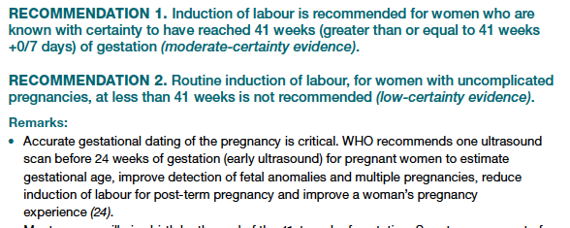
2022

Slide 28
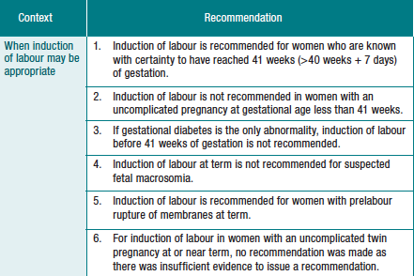

Slide 29
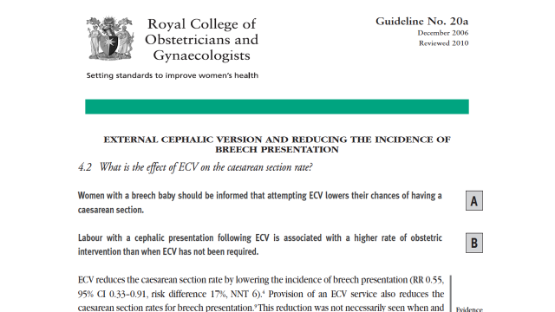
Fetal Malpresentation
Breech presentation at 37 weeks of gestation is estimated to complicate 3.8% of pregnancies,
>85% of pregnant women with a persistent breech presentation are delivered by cesarean.
Lee HC, El-Sayed YY, Gould JB. , 1997-2003. Am JObstet Gynecol 2008;199:59.e1-8.
With successful external cephalic version vaginal delivery is possible

Slide 30
Suspected Fetal Macrosomia
Suspected Fetal Macrosomia is not an indication for CS.
To avoid potential birth trauma, ACOG recommends that cesarean delivery be limited to estimated fetal weights of
at least 5000 g in women without diabetes and
at least 4500 g in women with diabetes
Ultrasonography for estimated fetal weight in the third trimester is noted to be imprecise
Ultrasonography for estimated fetal weight in the third trimester should be used sparingly and with clear indications
Therefore, individualized, patient-centered counseling regarding the risks and benefits of vaginal and cesarean birth in cases of suspected macrosomia should be under- taken based on relevant clinical considerations

Slide 31



Systematic review: What Matters to Women during childbirth
WHO BOLD Project (2013-2018)
Objective: To describe what women want from intra-partum care based on open-ended accounts of their beliefs, values, and expectations about labour and childbirth.
The findings show that:
Women want a positive childbirth experience that fulfils or exceeds their prior personal and sociocultural beliefs and expectations.
Clinically and psychologically safe environment with
Continuity of practical and emotional support from a birth companion(s) and
Kind, sensitive , competent clinical staff, who provide reassurance
.
Normal birth (without intervention)
Normal birth (without intervention)
A healthy mother and baby
A healthy mother and baby
Support from a birth companion
Support from a birth companion
Desire to be in control
Desire to be in control
Sensitive, caring, kind, respectful staff
Sensitive, caring, kind, respectful staff
Some of the views shared by women included in the systematic review. Downe et al. 2018

Slide 32
Women Needs Respectful Maternity care What is Respectful Maternity Care?
Care organized for and provided to all women in a manner that maintains their;
dignity
privacy
confidentiality
ensures freedom from harm and mistreatment
enables informed choice
continuous support during labour and childbirth …
[WHO, 2018]

Slide 33
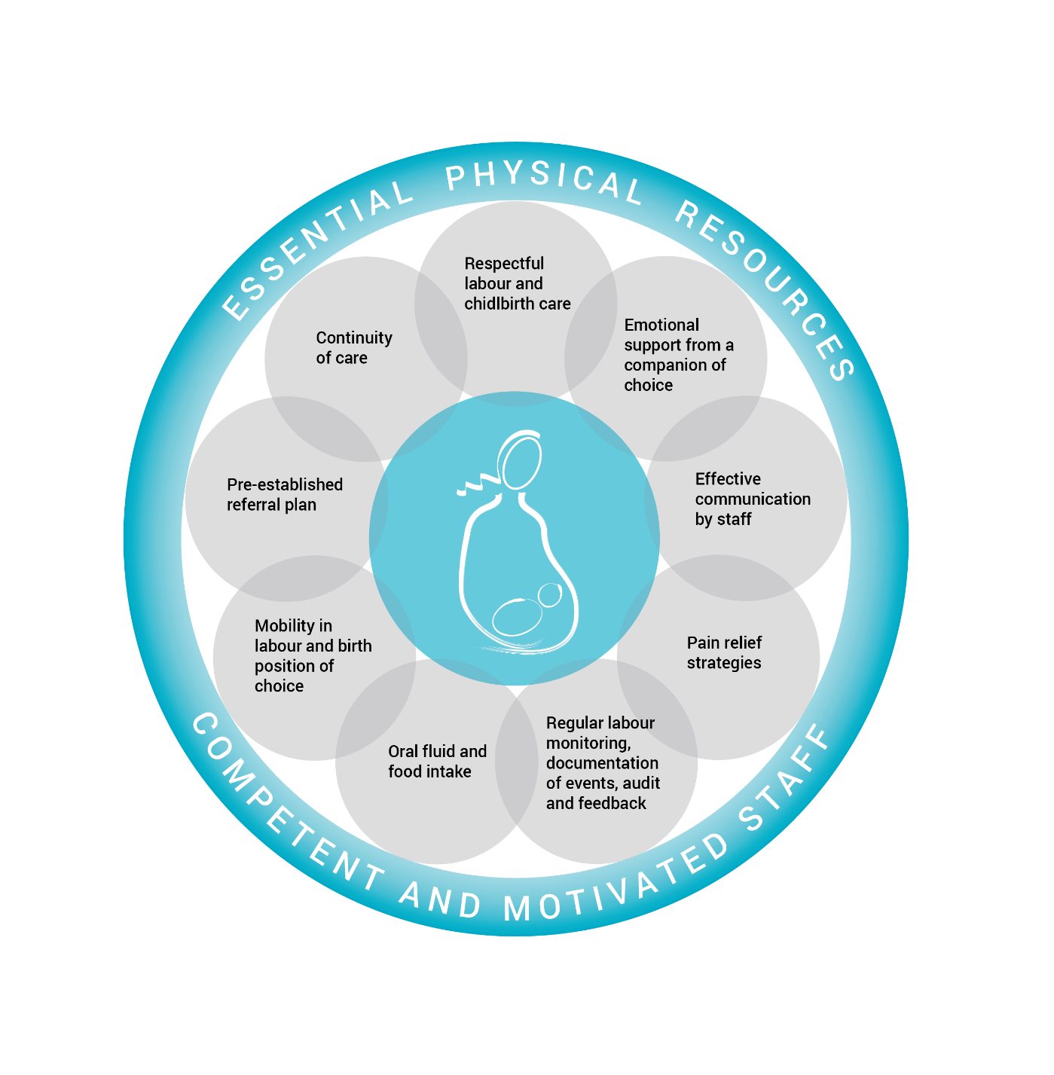
WHO INTRAPARTUM CARE MODEL
Pre established referral plan
Respectful labour
& childbirth care
Continuity of care
Mobility in labour &
Oral fluid & food Intake
Pain relief strategies
Emotional support
From companion of choice
Regular labour monitoring Documentation
Effective communication by staff
Birth position of Choice
[WHO, Intrapartum Care Guidelines 2018]

Slide 34
Companion of Choice
To be the advocate for the mother
To allay anxiety and provide reassurance
To provide hydration and nutrition
To provide nonmedical means of pain relief –massage, music, aroma therapy ……
To request for medical means of pain relief
To provide information on progress
To act as a liaison between mother & relatives

Slide 35
2017
Continuous support during labour may improve outcomes for women and infants
Increases spontaneous vaginal birth;
Reduces the duration of labour; any analgesia & regional analgesia
May reduce CS, IVD, low 5 min Apgar scores, negative feelings about
childbirth experiences
No evidence of harm of continuous support/ promotes bonding & breast feeding
* Studies not uniform; companion should be trained for effective support

Slide 36
Mid-Wife led Models Maternity Service Organisational Interventions that aim to reduce caesarean section: a systematic review and meta- analyses Anna Chapman1,2, Cate Nagle3,4, Debra Bick5, Rebecca Lindberg6, Bridie Kent7, Justin Calache1,2 and Alison M. Hutchinson1 BMC Pregnancy and Childbirth (2019) 19:206 https://doi.org/10.1186/s12884-019-2351-2
Background: Caesarean sections (CSs) are associated with increased maternal and perinatal morbidity, yet rates continue to increase within most countries. This paper reports findings of a systematic review of literature related to maternity service organisational interventions that have a primary intention of improving CS rates.
Results: Fifteen articles were included in the systematic review,
Results indicated that, compared with women allocated to usual care, women allocated to midwife-led models of care implemented across pregnancy, labour and birth, and the postnatal period were, on average, less likely to experience CS (overall) (average RR 0.83, 95% CI 0.73 to 0.96), planned CS (average RR 0.75, 95% CI 0.61 to 0.93), and episiotomy (average RR 0.84, 95% CI 0.74 to 0.95). Narratively, audit and feedback, and a hospital policy of mandatory second opinion for CS, were identified as interventions that have potential to reduce CS rates.
Conclusion: Maternity service leaders should consider the adoption of midwife-led models of care across the maternity episode within their organisations, particularly for women classified as low-risk.
Additional studies are required that utilise either audit and feedback, or a hospital policy of mandatory second opinion for CS, to facilitate the quantification of intervention effects within future reviews.

Slide 37

Recommendations / Best Practices
Establish clear clinical guidelines for labour progression, indications for CS (particularly in first labour or low-risk women), with threshold criteria.
Use tools such as WHO Labour Care Guide to better define active labour onset, avoid early diagnosis of labour arrest, give adequate time for progression.
Audit & feedback systems with mandatory second opinions especially for certain indications (e.g. arrest of labour, fetal distress) to reduce unneeded decisions.
Strengthen midwife-led care models and continuous support in labour—companionship, mobility, upright positions
Enhance antenatal care & patient education so women/families understand risks/benefits, feel empowered to participate in decisions.
Monitor & classify CS rates using Robson classification to identify where most unnecessary CS are happening (e.g. first time mothers, induced labour etc.).
Ensure policy/levers align: financial incentives, hospital protocols, insurance/payment structures should not favour CS over vaginal delivery unnecessarily.
Evaluate safety and outcome continuously—ensuring any reduction in CS does not compromise maternal or neonatal outcomes.

Slide 38

FIGO position paper: how to stop the caesarean section epidemic
The delivery fees for physicians for undertaking CS and attending vaginal delivery should be the same, using a mean fee. This should also happen in private practice settings.
Hospitals should be obliged to publish annual CS rates, and financing of hospitals should be partly based on CS rates. Risk-adjusted CS rates should become available.
Hospitals should use a uniform classification system for CSs (Robson/WHO classification).1,13
Women should be informed properly on the benefits and risks of a CS.
Money that will become available from lowering CS costs should be invested in resources, better preparation for labour and delivery and better care, adequate pain relief, practical skills training for doctors and midwives, and reintroduction of vaginal instrumental deliveries to reduce the need for CS in the second stage of labour.
The situation in very low-income countries requires specific attention, considering that access to CSs is still insufficient in rural areas, whereas CSs seem to rise inappropriately in some urban areas and can be associated with substantial maternal morbidity and mortality.9,14 Both situations are unwanted. In rural areas, adequate access to skilled care, to appropriate fetal surveillance, and to assisted births or operative delivery is essential.

Slide 39
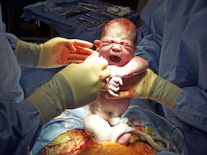
The image of our profession
Solving all problems
with a c-section
We should regain our role as Obstetricians
Maintain our obstetric competencies
Inform and respect women’s choices
THANK YOU

Slide 40

Join us at AOFOG 2026 –
Connect, learn, and shape the future
of women’s health across Asia-Oceania."
Join the leaders, innovators, and changers in Obstetrics & Gynaecology
See you at

